Slide 1

The genetic legacy of the deliberate introduction of Pacific oysters
Erik Sotka
Allan Strand
Ryan Carnegie, Jim Carlton, Lucia Couceiro, Jeff Crooks, Hikaru Endo, Hilary Heyford, Masakazu Hori, Mits Kamiya, Gen Kanaya, Judith Kochmann, Kun-Seop Lee, Lauren Lees, Hannah Miller, Massa Nakaoka, Eric Pante, Jennifer Ruesink, Evangelina Schwindt, Åsa Strand, Richard Taylor, Ryuta Terada, Martin Thiel, Takefumi Yorisue, Danielle Zacherl

Slide 2
Crassostrea (Magallana) gigas Pacific cupped oyster

Slide 3
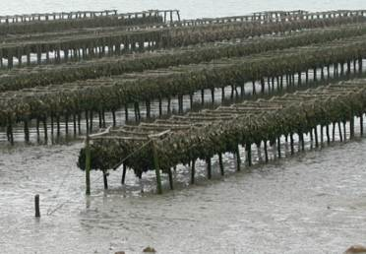
Crassostrea (Magallana) gigas Pacific cupped oyster
Among the most important aquacultural shellfish worldwide
C. gigas aquaculture
- $1.2 Billion per year
- 644,000 tons per year
*Naylor et al., 2001, Ruiz et al. 2015, Ruesink et al. 2000

Slide 4
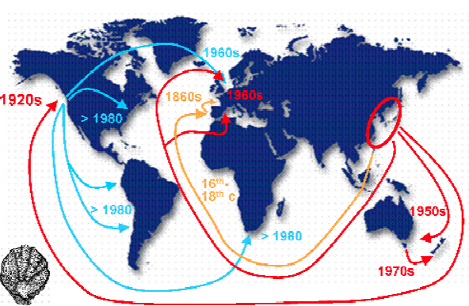
Crassostrea (Magallana) gigas Pacific cupped oyster
Among the most important aquacultural shellfish worldwide
Deliberately introduced to five continents for at least 150 years
* REFERENCE???

Slide 5
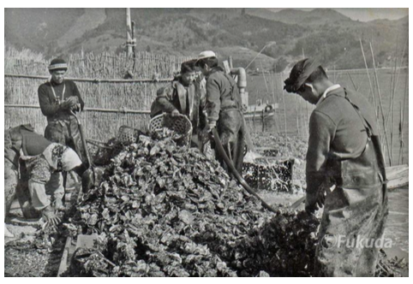
Crassostrea (Magallana) gigas Pacific cupped oyster
Among the most important aquacultural shellfish worldwide
Deliberately introduced to five continents for at least 150 years
The second most frequent vector for the transport of nonnative marine and estuarine species worldwide*
Professor Yasuyuki Koike
Oyster World Congress 2012
*Naylor et al., 2001, Ruiz et al. 2015, Ruesink et al. 2000

Slide 6
Genetic legacy of Pacific oyster introductions
Population genetic structure of native Pacific oysters (China, Korea, Japan)
The invasion history of non-native populations (USA, Europe, NZ, South America)
Signatures of Pacific oysters on putatively co-introduced species (algae and invertebrates)

Slide 8
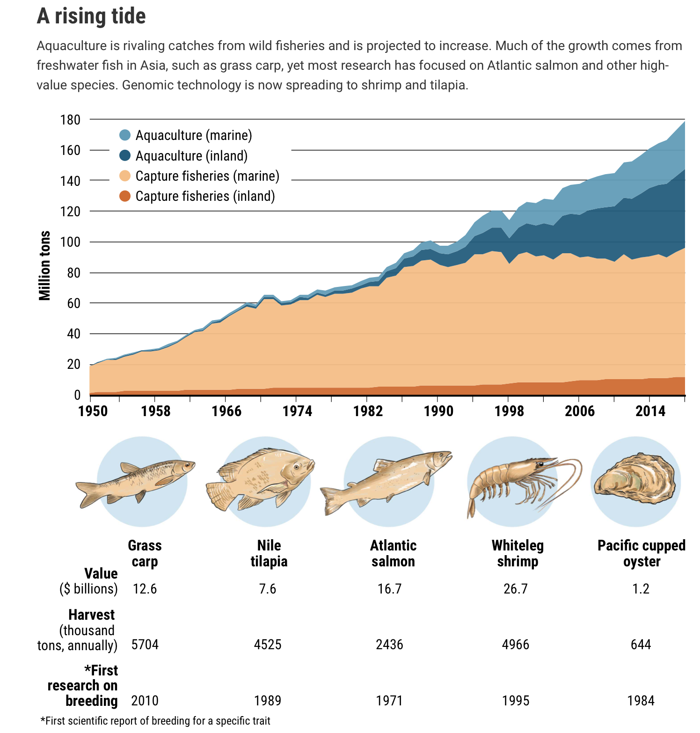
C. gigas aquaculture
$1.2 Billion per year
644,000 tons per year
Stokstad E (2020) Science
Notes:
$1.2 Billion in C. gigas aquaculture. 644 thousand tons annually

Slide 9
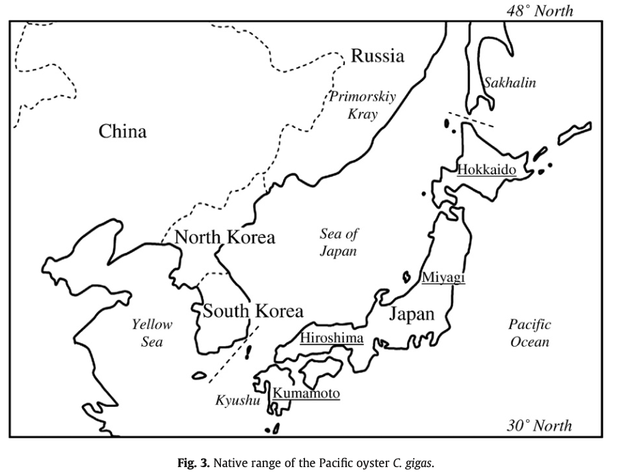
Troost 2010
Journal of Sea Research

Slide 10
Professor Yasuyuki Koike
Oyster World Congress 2012

Slide 11
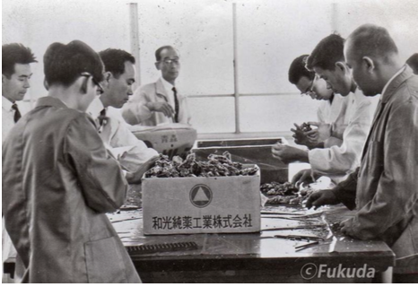
Professor Yasuyuki Koike
Oyster World Congress 2012

Slide 12
Global distribution of C. gigas
525 occurrences – BS in MBIO (2019) Holly Caudle

Slide 13
Movement and sources of Crassostrea gigas are based on historical records
Hiroshima
Miyagi
Kumamoto
Notes:
According to archival records, the source of many introductions to North America were from the “Miyagi” region, an area of intense aquacultural production today (see Figure 1; NRC 2004; Barrett 1963), though there are some indications of introductions from other Japanese populations (“Hiroshima” and “Hokkaido” strains; see Figure 1), and South Korea and China. (Note: the oft-cited Kumamoto strain is the congener C. sikamea). However, the population sources of most oyster introductions are likely incomplete, as an unknown frequency of oyster introductions were never officially reported (NRC 2004).

Slide 14
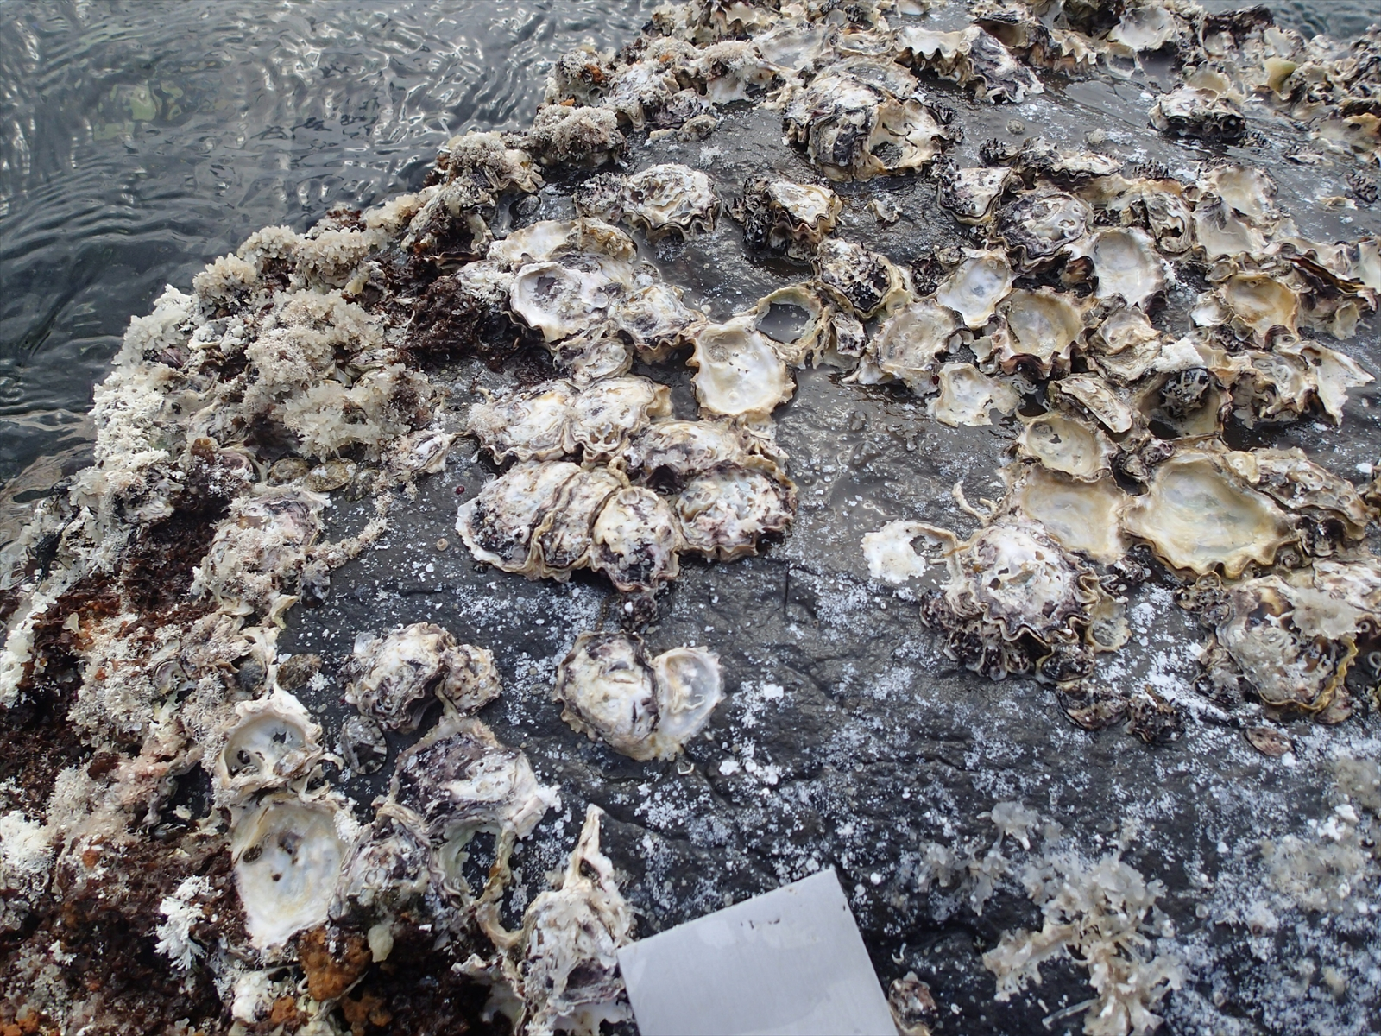
Dr. Gen Kanaya, Takahama, Japan

Slide 15
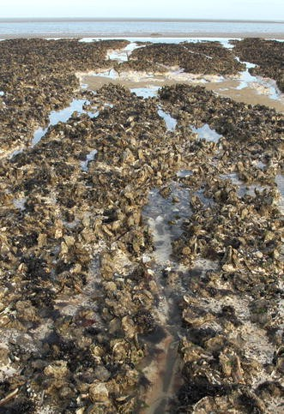
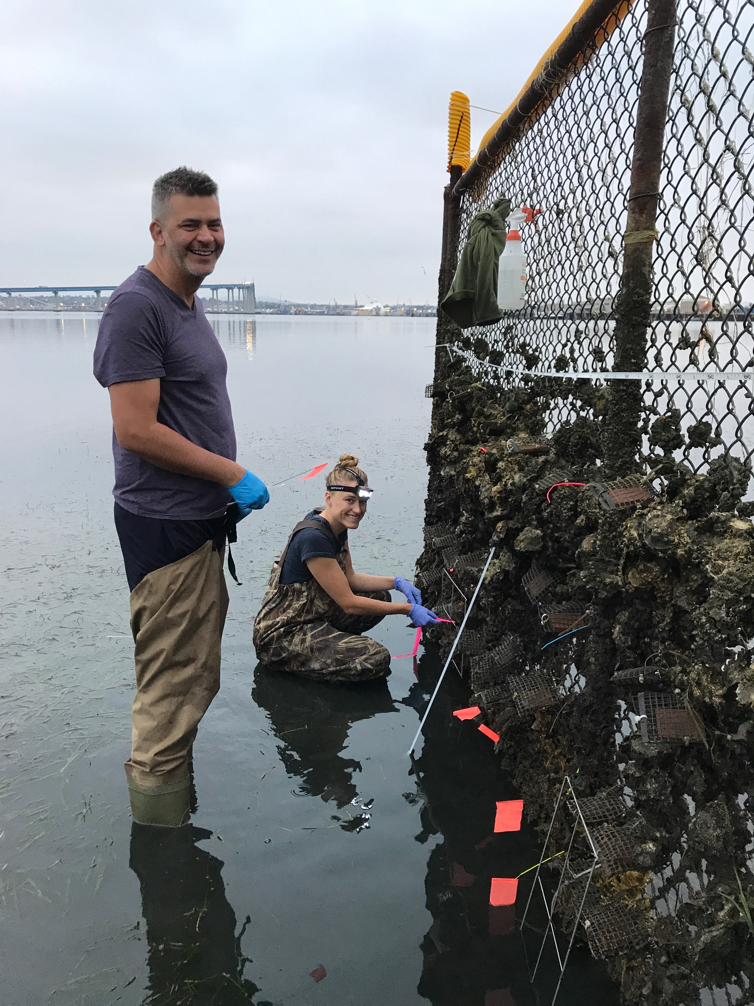
England
Southern California

Slide 16
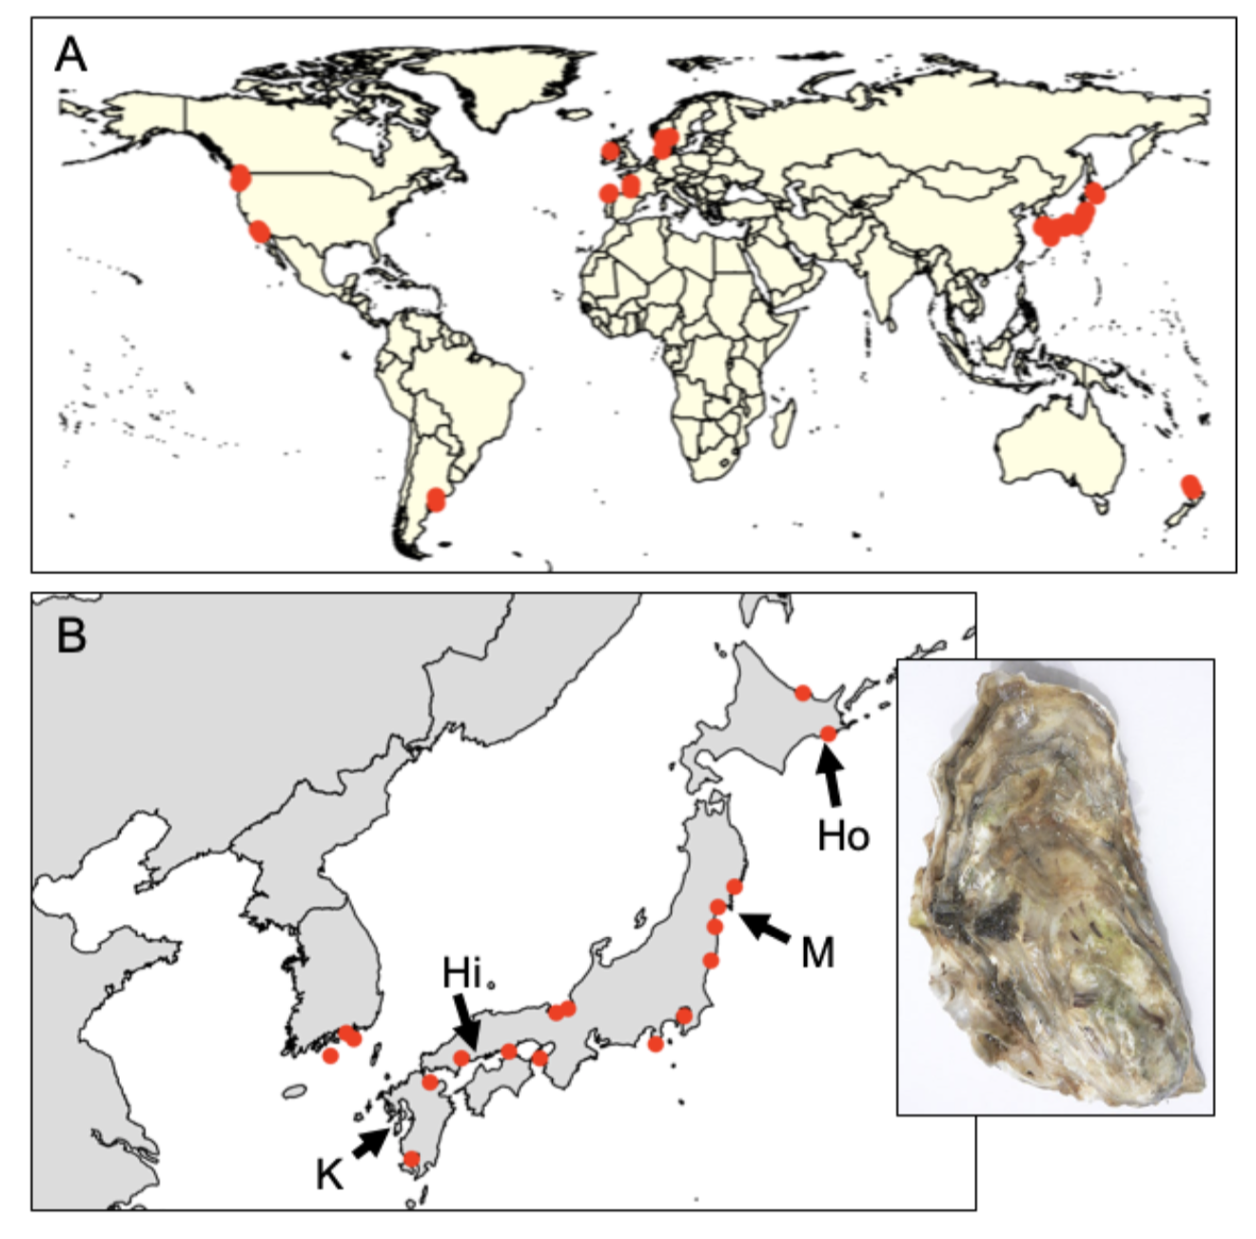
41 populations (20 native and 21 non-native)
Feral populations (on rocks, jetties, reefs, etc..)
Genotype-by-sequencing
Dataset: 726 individuals from 7046 loci (no missing data and at HWE)

Slide 17
Genetic legacy of Pacific oyster introductions
Population genetic structure of native Pacific oysters (China, Korea, Japan)
The invasion history of non-native populations (USA, Europe, NZ, South America)
Signatures of Pacific oysters on putatively co-introduced species (algae and invertebrates)

Slide 18
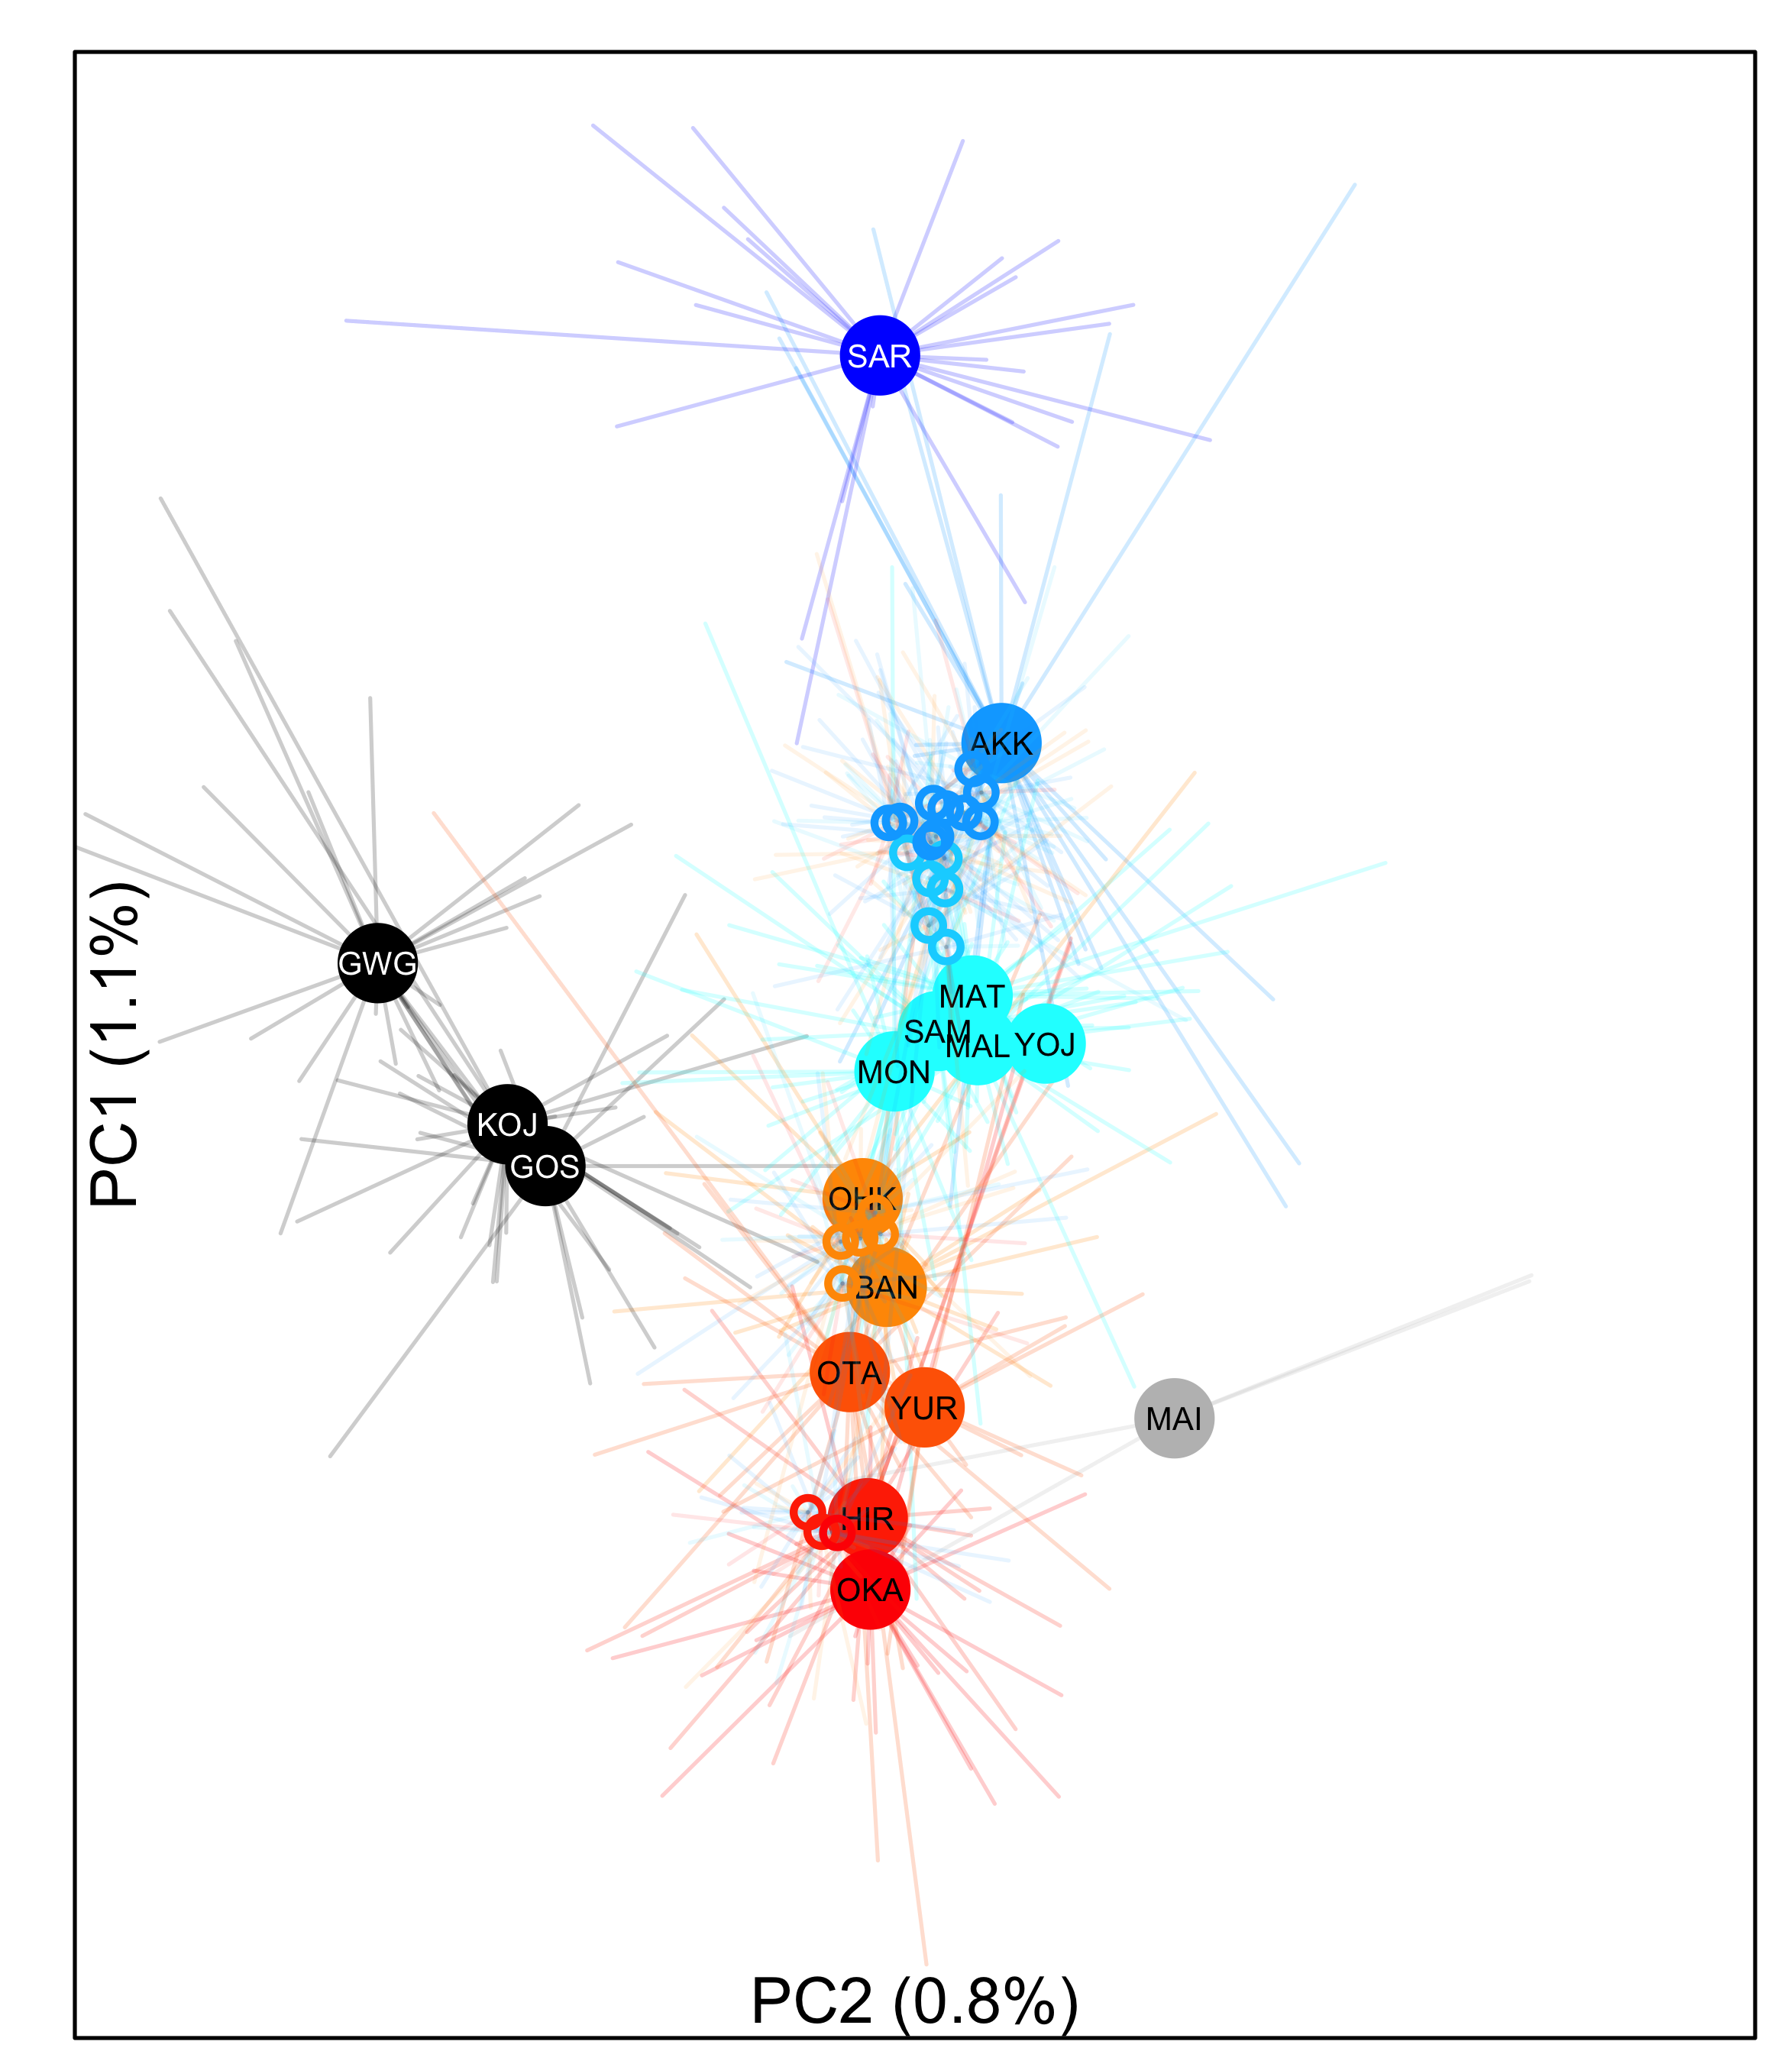
Genetic differentiation along latitude in Japan Phi_{st} = 0 to 0.011
Hokkaido
Miyagi
Hiroshima

Slide 19
Genetic legacy of Pacific oyster introductions
Population genetic structure of native Pacific oysters (China, Korea, Japan)
The invasion history of non-native populations (USA, Europe, NZ, South America)
Signatures of Pacific oysters on putatively co-introduced species (algae and invertebrates)

Slide 20
Genetic differentiation between non-native populations

Slide 21
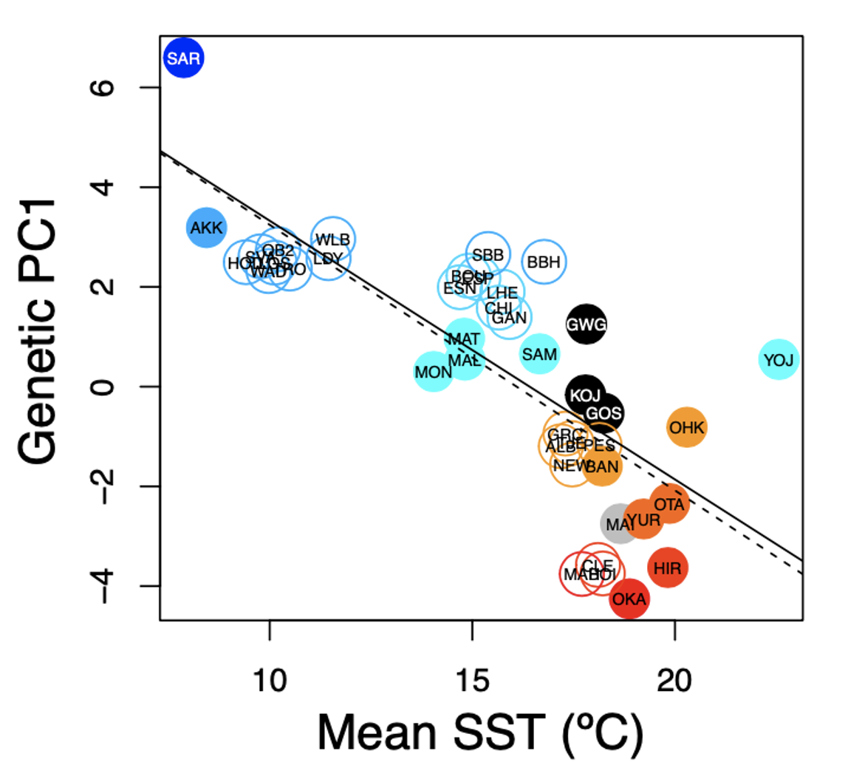
“Deliberate” ecological fitting (aka strain selection) during introductions
Native: r² = -0.777; p< 0.001
Introduced r² = -0.744; p< 0.001

Slide 22
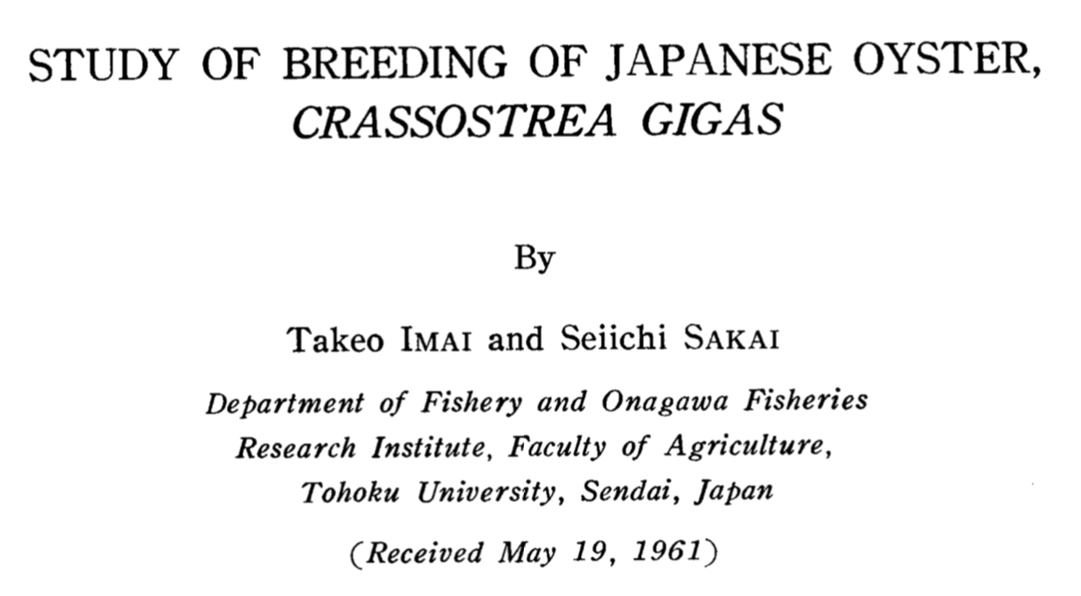
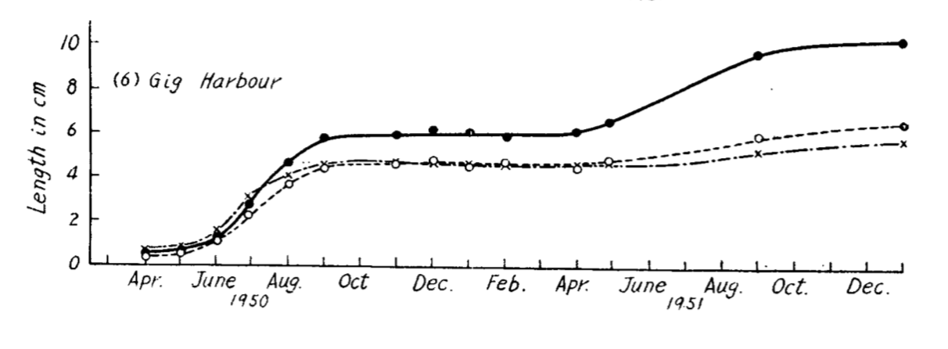
Northern (44ºN) Japanese oysters had greater fitness in Puget Sound WA (47ºN) relative to Southern (33ºN) Japanese oysters
Northern Japan oysters (38% mortality)
Southern Japan oysters (74% mortality)
Northern Japan
Southern Japan

Slide 23
Genetic legacy of Pacific oyster introductions
Population genetic structure of native Pacific oysters (China, Korea, Japan)
The invasion history of non-native populations (USA, Europe, NZ, South America)
Signatures of Pacific oysters on putatively co-introduced species (algae and invertebrates)

Slide 24
The greatest agency of all that spreads marine animals to new quarters of the world must be the business of oyster culture, a very ancient and world-wide craft. – Charles Elton (1958)

Slide 25
Pacific oysters from Europe and Canada, Washington state came from northern Japan
Circlize plots; Machine learning

Slide 26
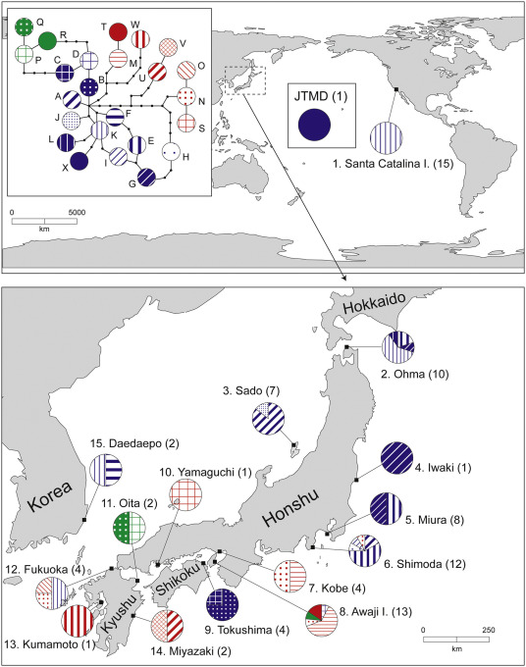

Slide 27
Pacific oysters from southern California are a mix of northern and southern Japan
Pacific oysters from New Zealand came from southern Japan
Circlize plots; Machine learning

Slide 28
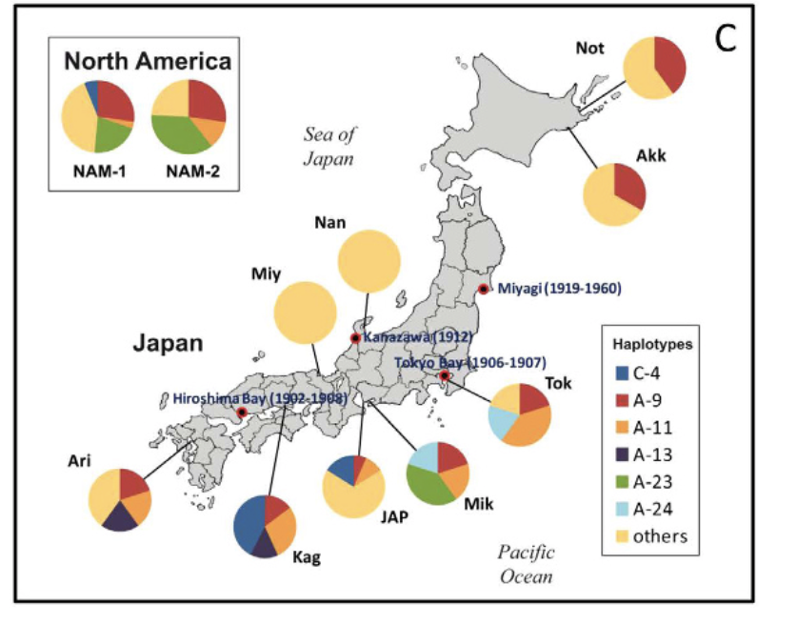
Notes:
Ruditapes

Slide 29
Results (so far)
We can trace genetic history of feral Crassostrea gigas back to native sources
Northern Japan was source for NW North America, southern Europe
Southern Japan source for California and New Zealand
Strange “hybrid” / inbred line / Sea of Japan lineage is found in South America and northern Europe
The environment of native sources predicts local non-native environments.
This suggests either ecological fitting or strain dispersal (or others?)

Slide 30
We note that our approach is to collect feral populations today to infer neutral dispersal patterns that occurred in the past; thus, our interpretations of geographic patterns must keep this limitation in mind. For example, concluding that Pacific Northwest individuals came from northern Japan and southern California from southern Japan may indicate a) the historical record is incorrect or b) the historical record is correct, oysters arrived from all over Japan, but a subset of genotypes created feral populations that survive today.

Slide 31
Argentina | Evangelina Schwindt
Chile | Martin Thiel, Jim Carlton
Denmark | Asa Strand
France | Eric Pante
Ireland | Asa Strand, Judith Kochmann
Japan | Takefumi Yorisue, Masahiro Nakaoka, Mits Kanaya, Masahiro Hori, Gen Kanaya, Ryuta Terada, Hikaru Endo
Korea | Kun-Seop Lee
New Zealand | Richard Taylor
Norway | Asa Strand
USA | Jennifer Ruesink, Hilary Heyford, Danielle Zacherl, Jeff Crooks
Spain | Lucia Couceiro
Sweden | Asa Strand, Judith Kochmann

Slide 33
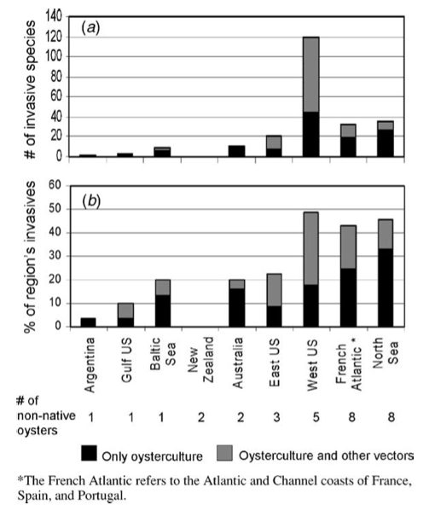
Dozens of species that moved with C. gigas
Ruesink et al. 2005 ARES

Slide 34
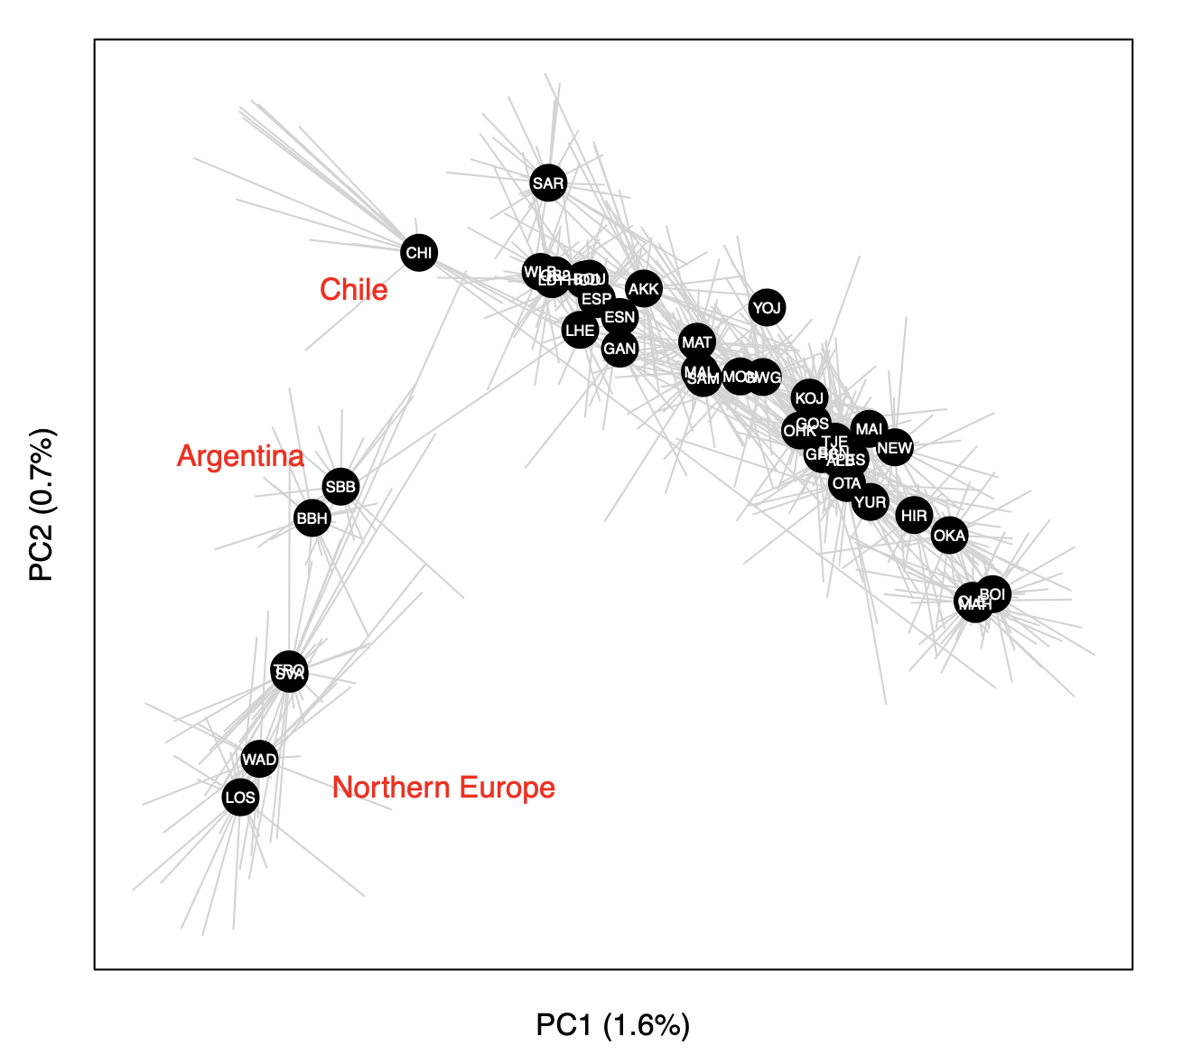
Principal components analysis (PCA) of 726 oysters using 7046 loci

Slide 35
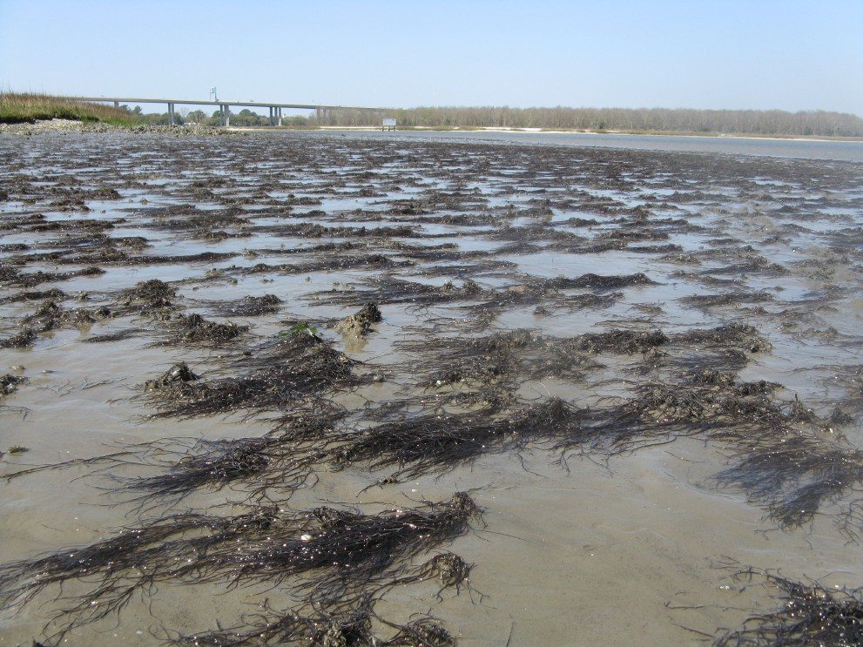
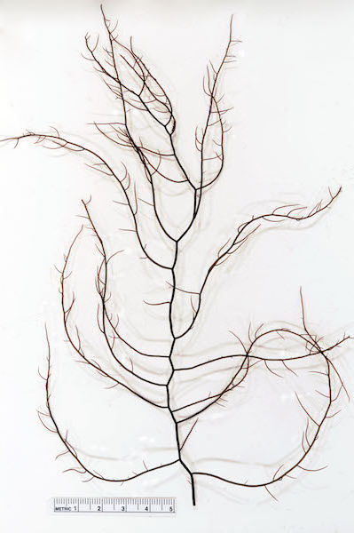
Agarophyton vermiculophyllum
(aka Gracilaria vermiculophylla)

Slide 36
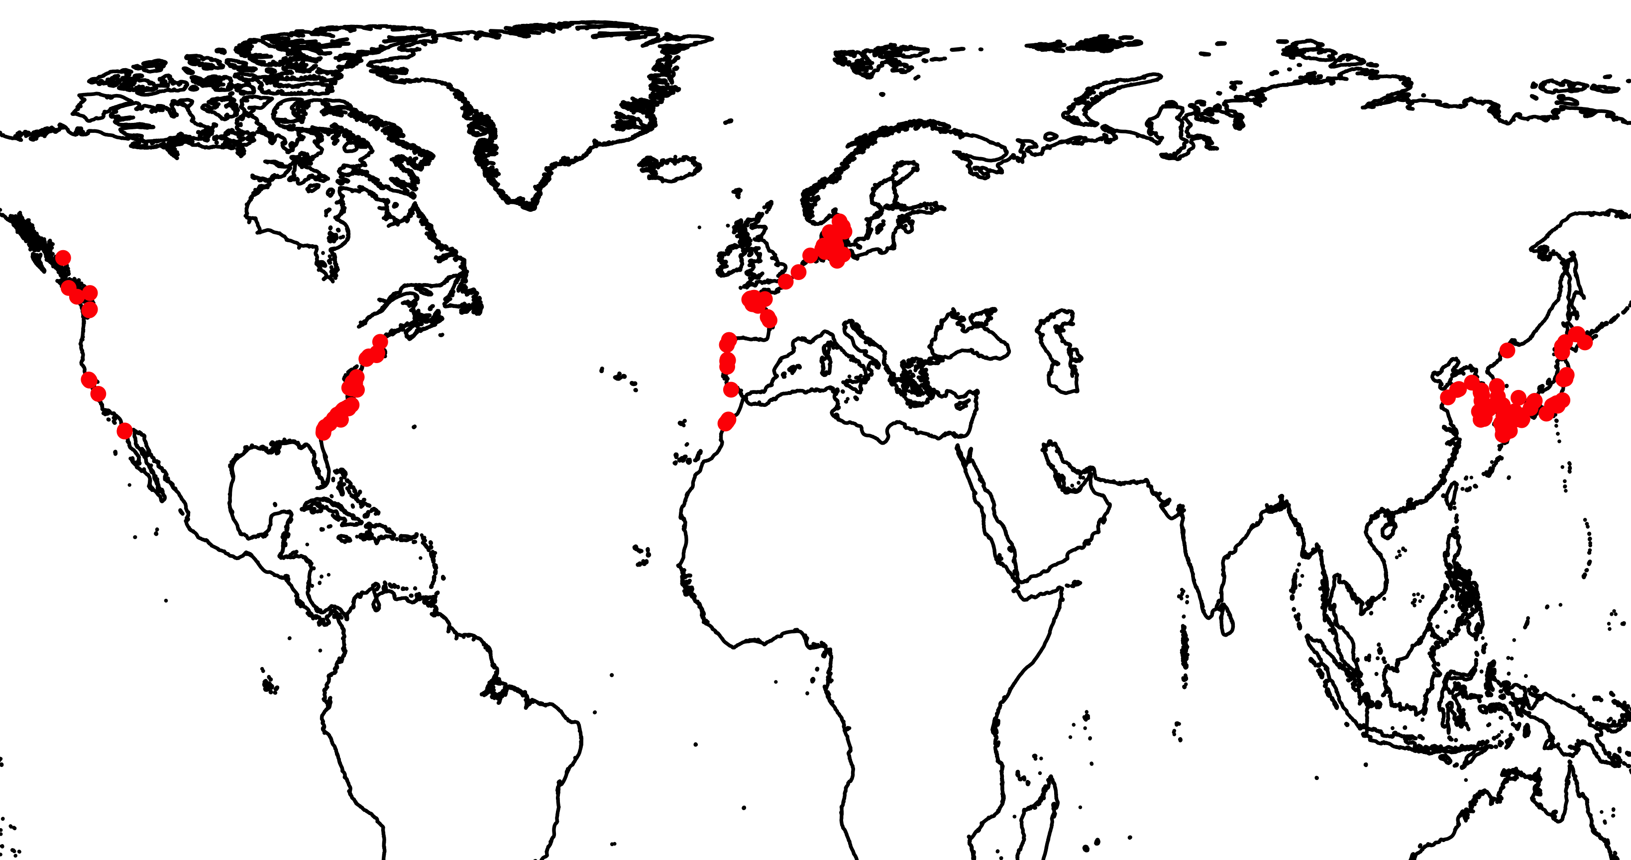
G. vermiculophylla distribution
Introduced: Europe
Introduced: North America
Native

Slide 37
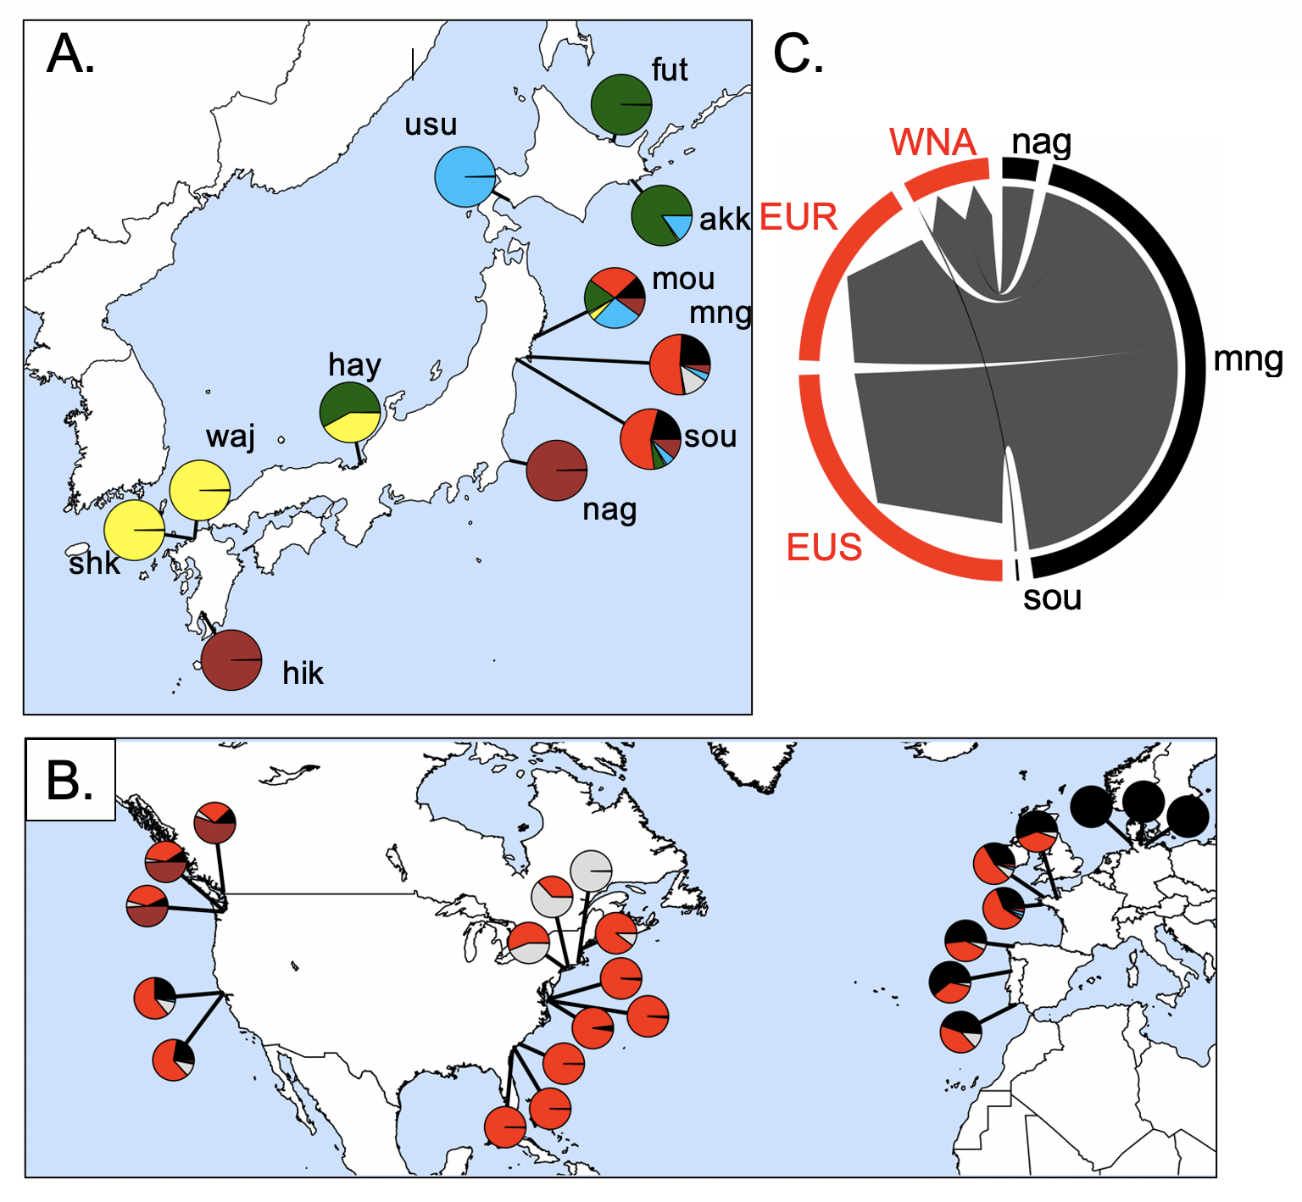
Source of the invasion is northeastern Japan
62,235 SNPs
32 populations
Admixture analysis
Flanagan, Krueger-Hadfield, Murren, Nice, Strand and Sotka (in press) Molecular Ecology

Slide 38
Source of the invasion is northeastern Japan
Annual Sea Surface
Temperature (ºC)
Flanagan, Krueger-Hadfield, Murren, Nice, Strand and Sotka (in press) Molecular Ecology

Slide 39
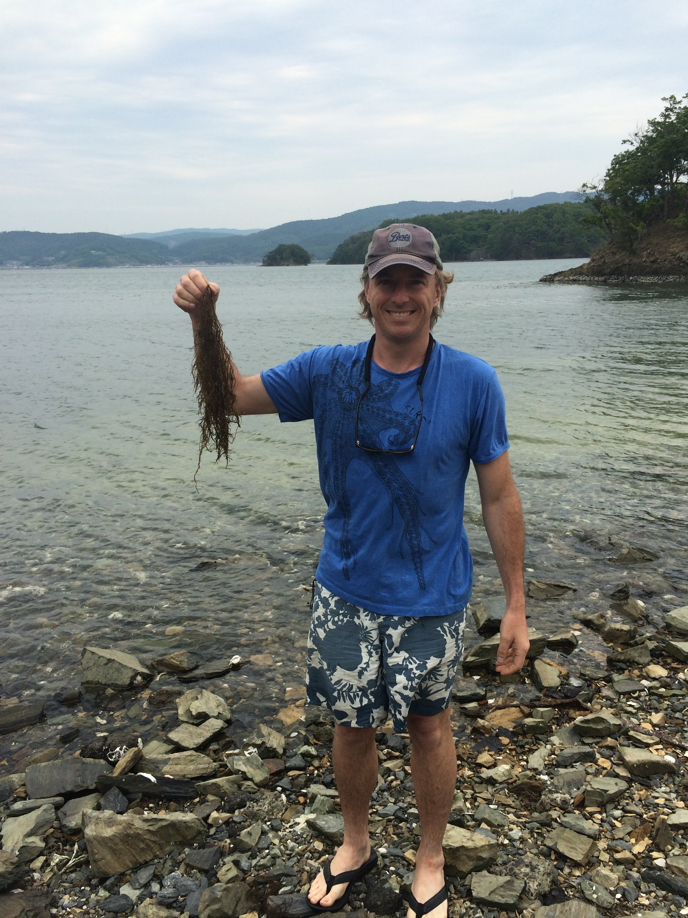
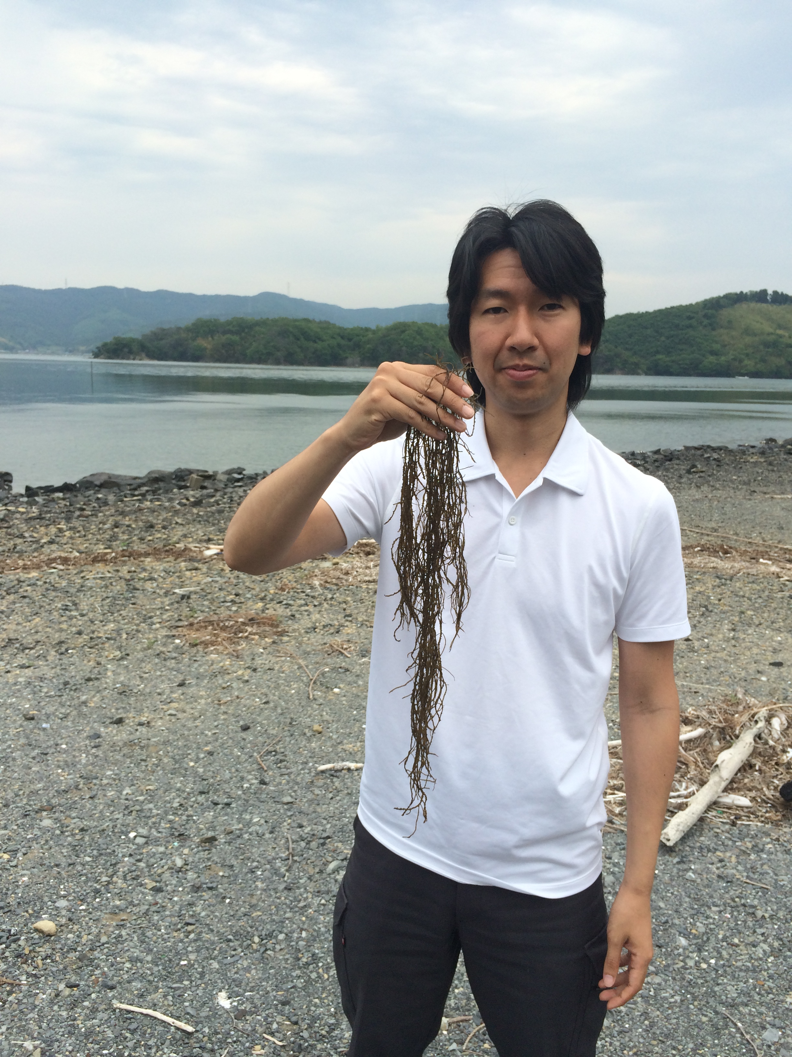
Mangoku-ura, Japan
May 2015

